Slide 1
Modules and Concurrency

Slide 2
Modules (exports/require)
Concurrency (Without THREADS!)

Slide 3
Defining and Using Node Modules

Slide 4
What exactly is a Module?

Slide 5
Module (In Node.js)
A file (or a folder) that contains code

Slide 6
Node’s Global Object

Slide 7
The Event Loop

Slide 8
The Event Loop
What Node uses to process asynchronous actions and interface them for you
so that you don’t have to deal with threads..

Slide 9
Errors vs Exceptions

Slide 10
Errors vs Exceptions
Error is “Problem”
Exception is “Condition”

Slide 11
Node Clusters

Slide 12
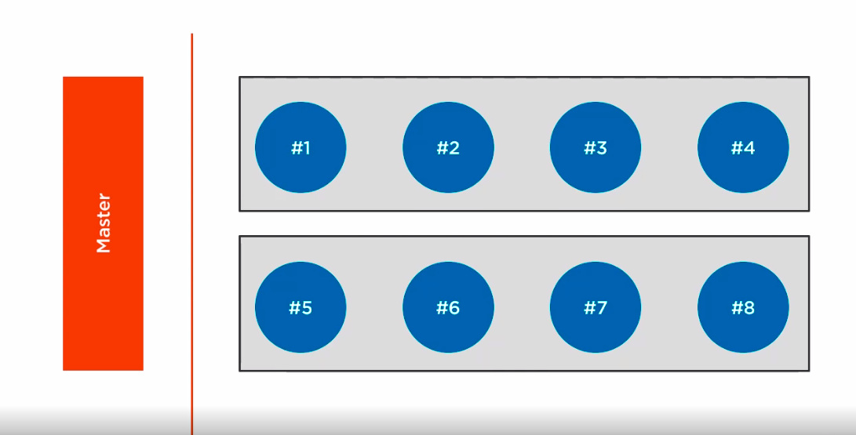

Slide 13
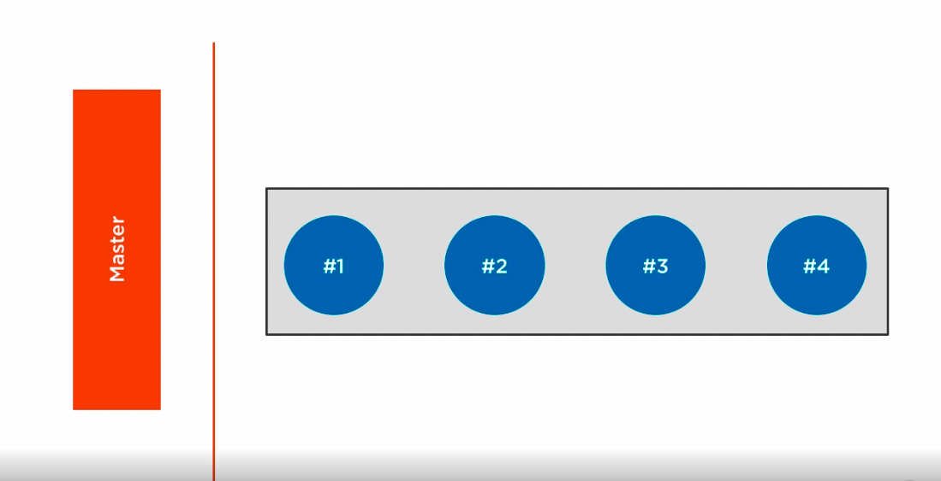

Slide 14
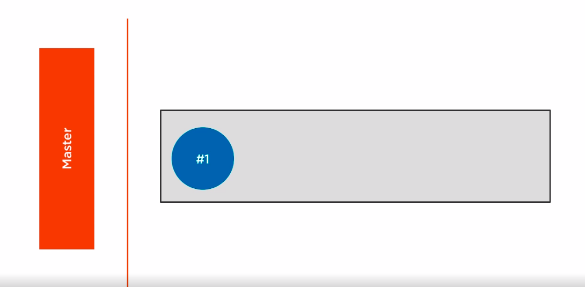

Slide 15
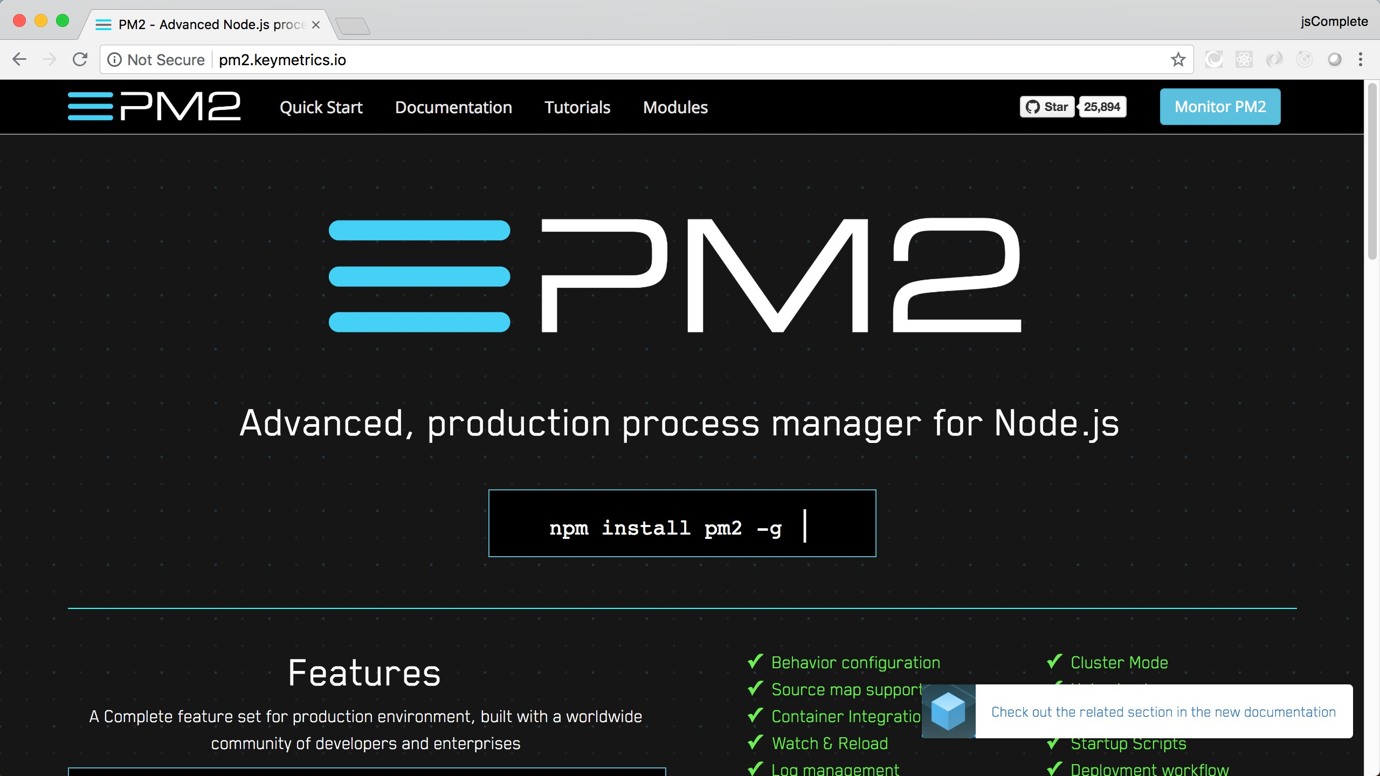

Slide 16
Node’s Asynchronous Patterns

Slide 17
ECMAScript Modules

Slide 18
Event Emitters

Slide 19

Node Modules
Types of APIs
Wrap Up
The “global” Object
The “Event Loop” Error handling
Clusters
Asynchronous patterns EventEmitter

Slide 20
Next Up
Working with Web Servers

